Slide 1
RETAIL EVENTS ANALYSIS WITH SQL & EXCEL

Slide 2
INTRODUCTION
The dataset contain promotions on the Retail events , including information about their category promotions , city , product names and campaign name. In today’s rapidly changing business landscape, understanding the impact of various events on revenue is crucial for making informed decisions and driving sustainable growth

Slide 3
campaign_id: This is a unique identifier for the marketing campaign. It helps in tracking and organizing different campaigns.
campaign_name: The name given to the marketing campaign, which often reflects its theme or purpose.
start_date: The date when the campaign officially begins or started being implemented.
end_date: The date when the campaign concludes or ends its active phase.
product_code: A specific identifier for the product being promoted. It uniquely identifies the product within your inventory or catalog.
product_name: The name or description of the product being promoted. It helps in identifying what exactly is being marketed.

Slide 4
category: The category to which the product belongs (e.g., homecare,personalcare,home appliances), providing context about the type of product.
event_id: An identifier for any specific event or occasion associated with the campaign, if applicable.
promotion_type: The type of promotion being used (e.g., discount, buy-one-get-one-free, seasonal sale).
quantity_sold (before_promotion): The number of units sold before any promotional activities or discounts were applied.
quantity_sold (after_promotion): The number of units sold after implementing the promotion, reflecting the effectiveness of the campaign
store_id: Identifier for the store or outlet where the sales occurred
city: The city where the store or sales location is situated.

Slide 5

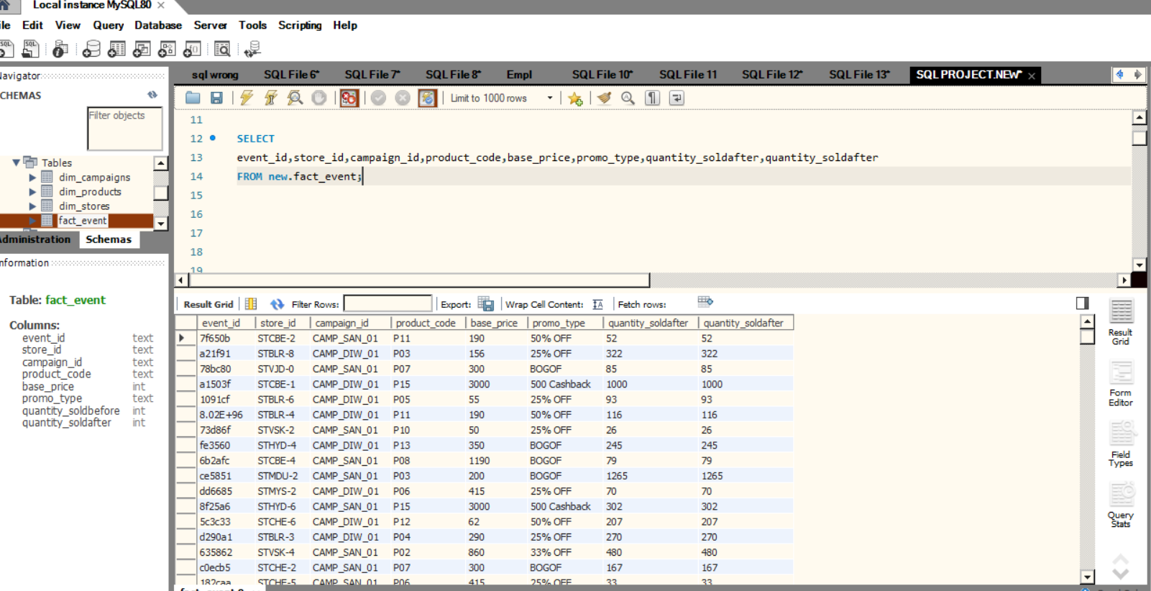
SELECT FACT_EVENT_DATA
SELECT
event_id,store_id,campaign_id,product_code,
base_price,promo_type,quantity_soldafter,quantity_soldafter
FROM new.fact_event;

Slide 6
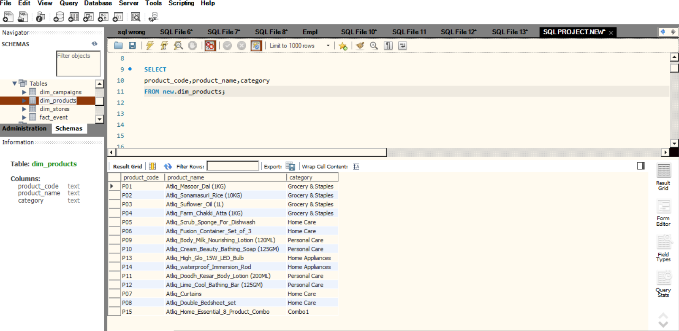
SELECT DIM_PRODUCTS_DATA
SELECT
product_code,product_name,category
FROM new.dim_products;

Slide 7
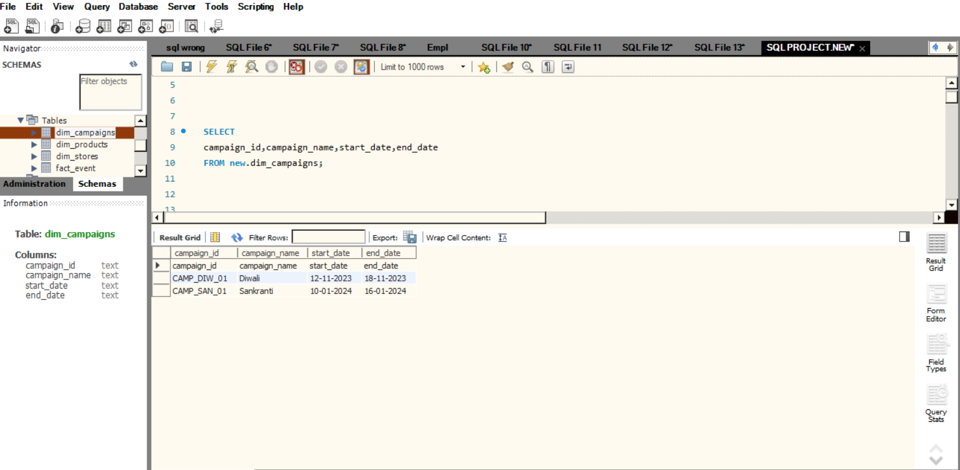
SELECT DIM_CAMPAIGNS_DATA
SELECT
campaign_id,campaign_name,start_date,end_date
FROM new.dim_campaigns;

Slide 8
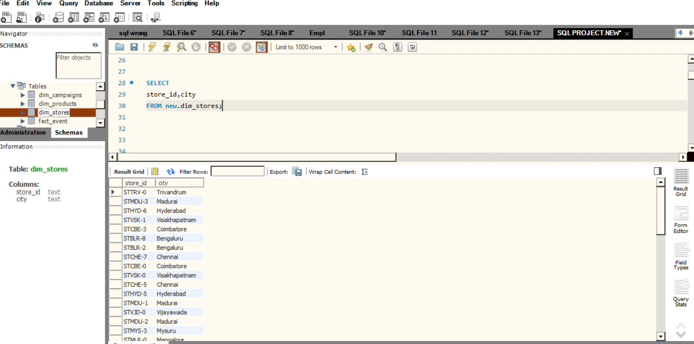
SELECT DIM_STORES_DATA
SELECT
store_id,city
FROM new.dim_stores;

Slide 9
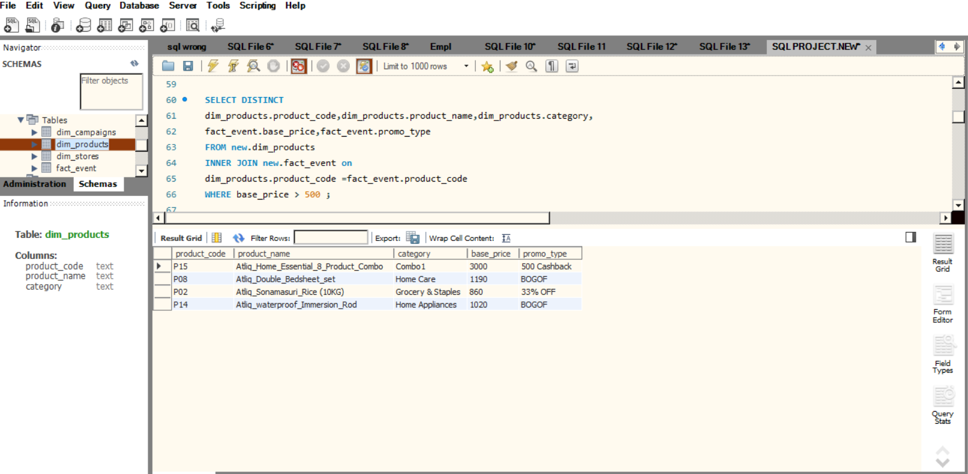
PRODUCTS WITH BASE_PRICE
SELECT DISTINCT
dim_products.product_code,dim_products.product_name,dim_products.category,
fact_event.base_price,fact_event.promo_type
FROM new.dim_products
INNER JOIN new.fact_event on
dim_products.product_code =fact_event.product_code
WHERE base_price > 500 ;

Slide 10
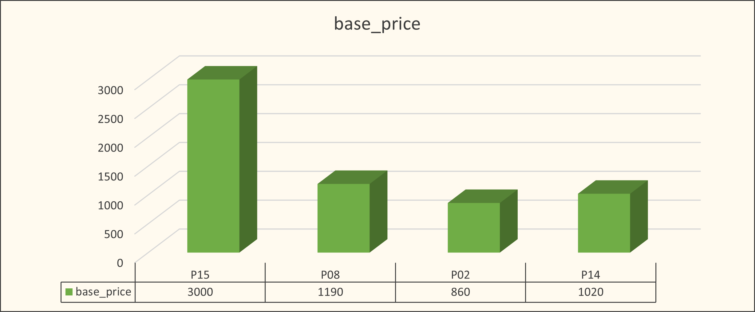
PRODUCTS WITH BASE_PRICE

Slide 11
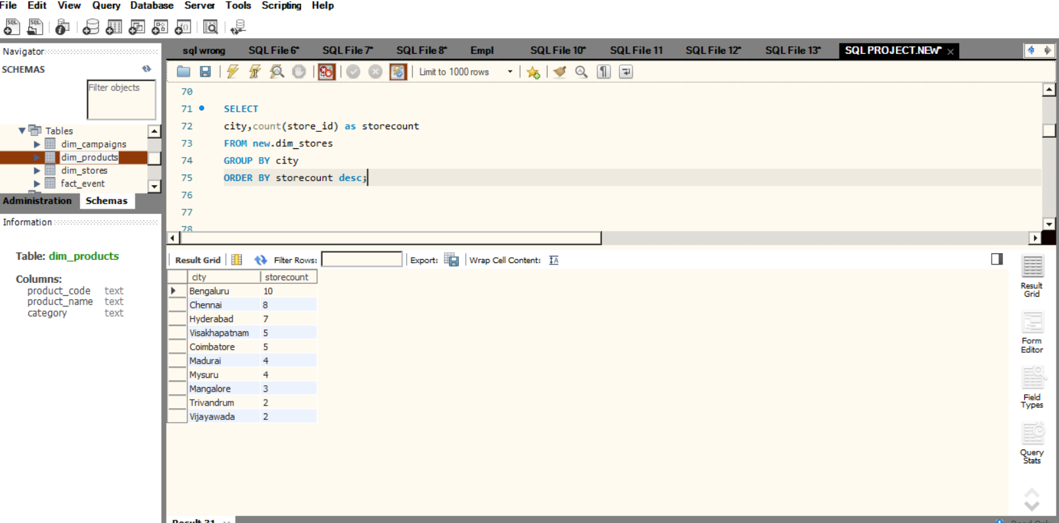
STORE COUNT BY CITY
SELECT
city,count(store_id) as storecount
FROM new.dim_stores
GROUP BY city
ORDER BY storecount DESC;

Slide 12
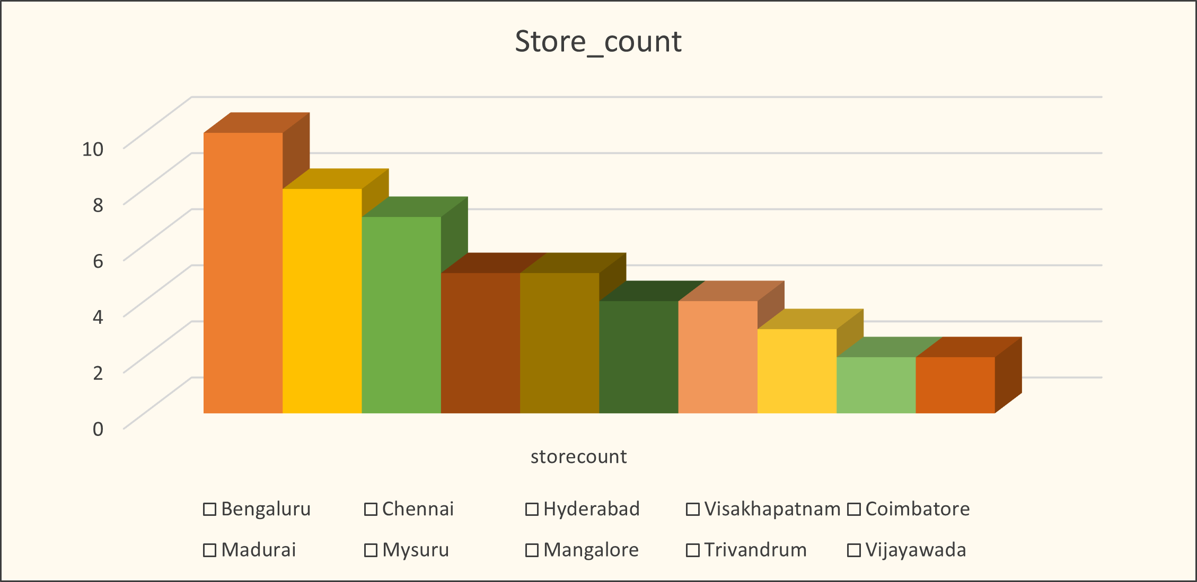
STORE COUNT BY CITY

Slide 13
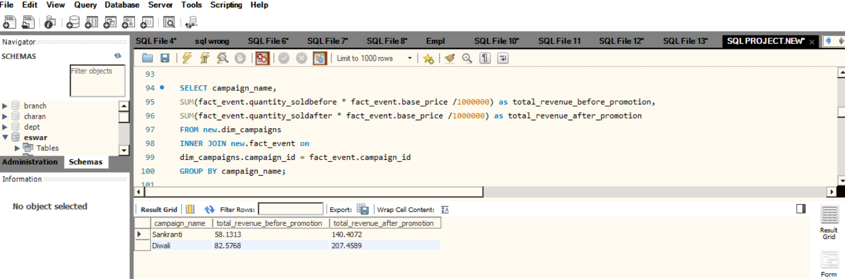
TOTAL REVENUE BEFORE & AFTER PROMOTIONS
SELECT campaign_name,
SUM(fact_event.quantity_soldbefore * fact_event.base_price /1000000) as total_revenue_before_promotion,
SUM(fact_event.quantity_soldafter * fact_event.base_price /1000000) as total_revenue_after_promotion
FROM new.dim_campaigns
INNER JOIN new.fact_event on dim_campaigns.campaign_id = fact_event.campaign_id
GROUP BY campaign_name;

Slide 14
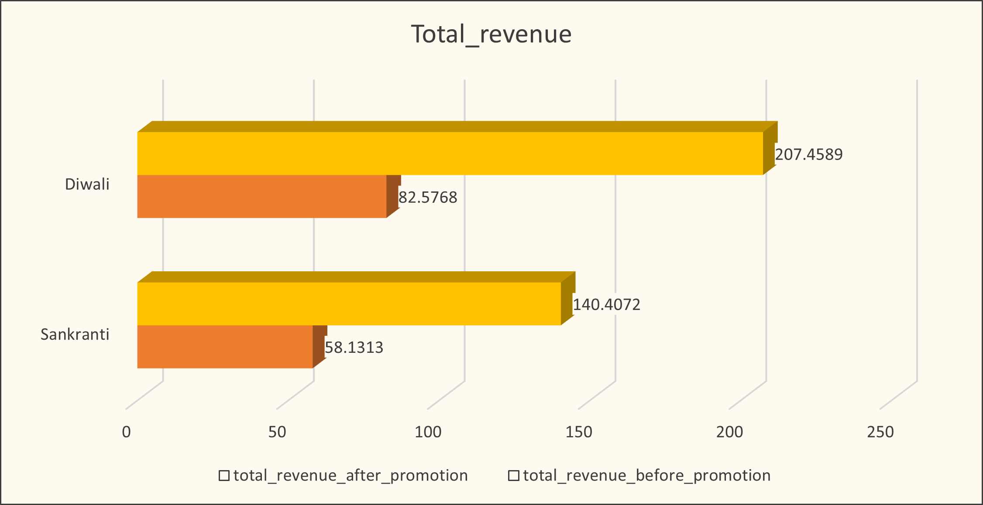
TOTAL REVENUE BEFORE & AFTER PROMOTIONS

Slide 15
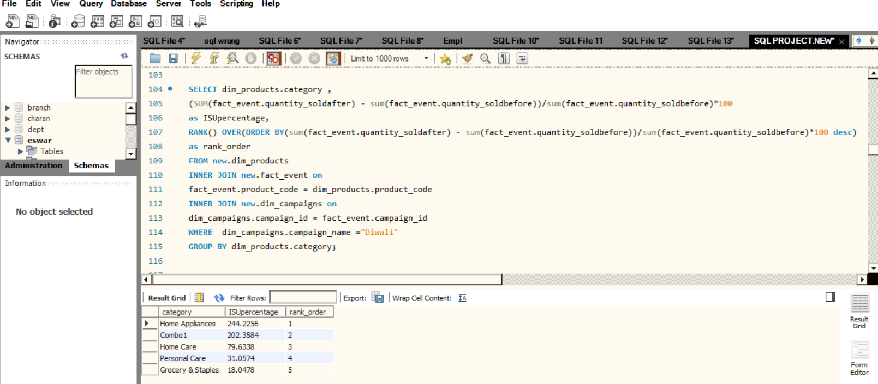
INCREMENT SOLD QUANTITY (ISU%)
SELECT dim_products.category
(SUM(fact_event.quantity_soldafter)-sum(fact_event.quantity_soldbefore))
/sum(fact_event.quantity_soldbefore)*100 as ISUpercentage,
RANK() OVER(ORDER BY(sum(fact_event.quantity_soldafter)-sum(fact_event.quantity_soldbefore))
/sum(fact_event.quantity_soldbefore)*100 desc)as rank_order
FROM new.dim_products
INNER JOIN new.fact_event on
fact_event.product_code = dim_products.product_code
INNER JOIN new.dim_campaigns on
dim_campaigns.campaign_id = fact_event.campaign_id
WHERE dim_campaigns.campaign_name ="Diwali“
GROUP BY dim_products.category;

Slide 16
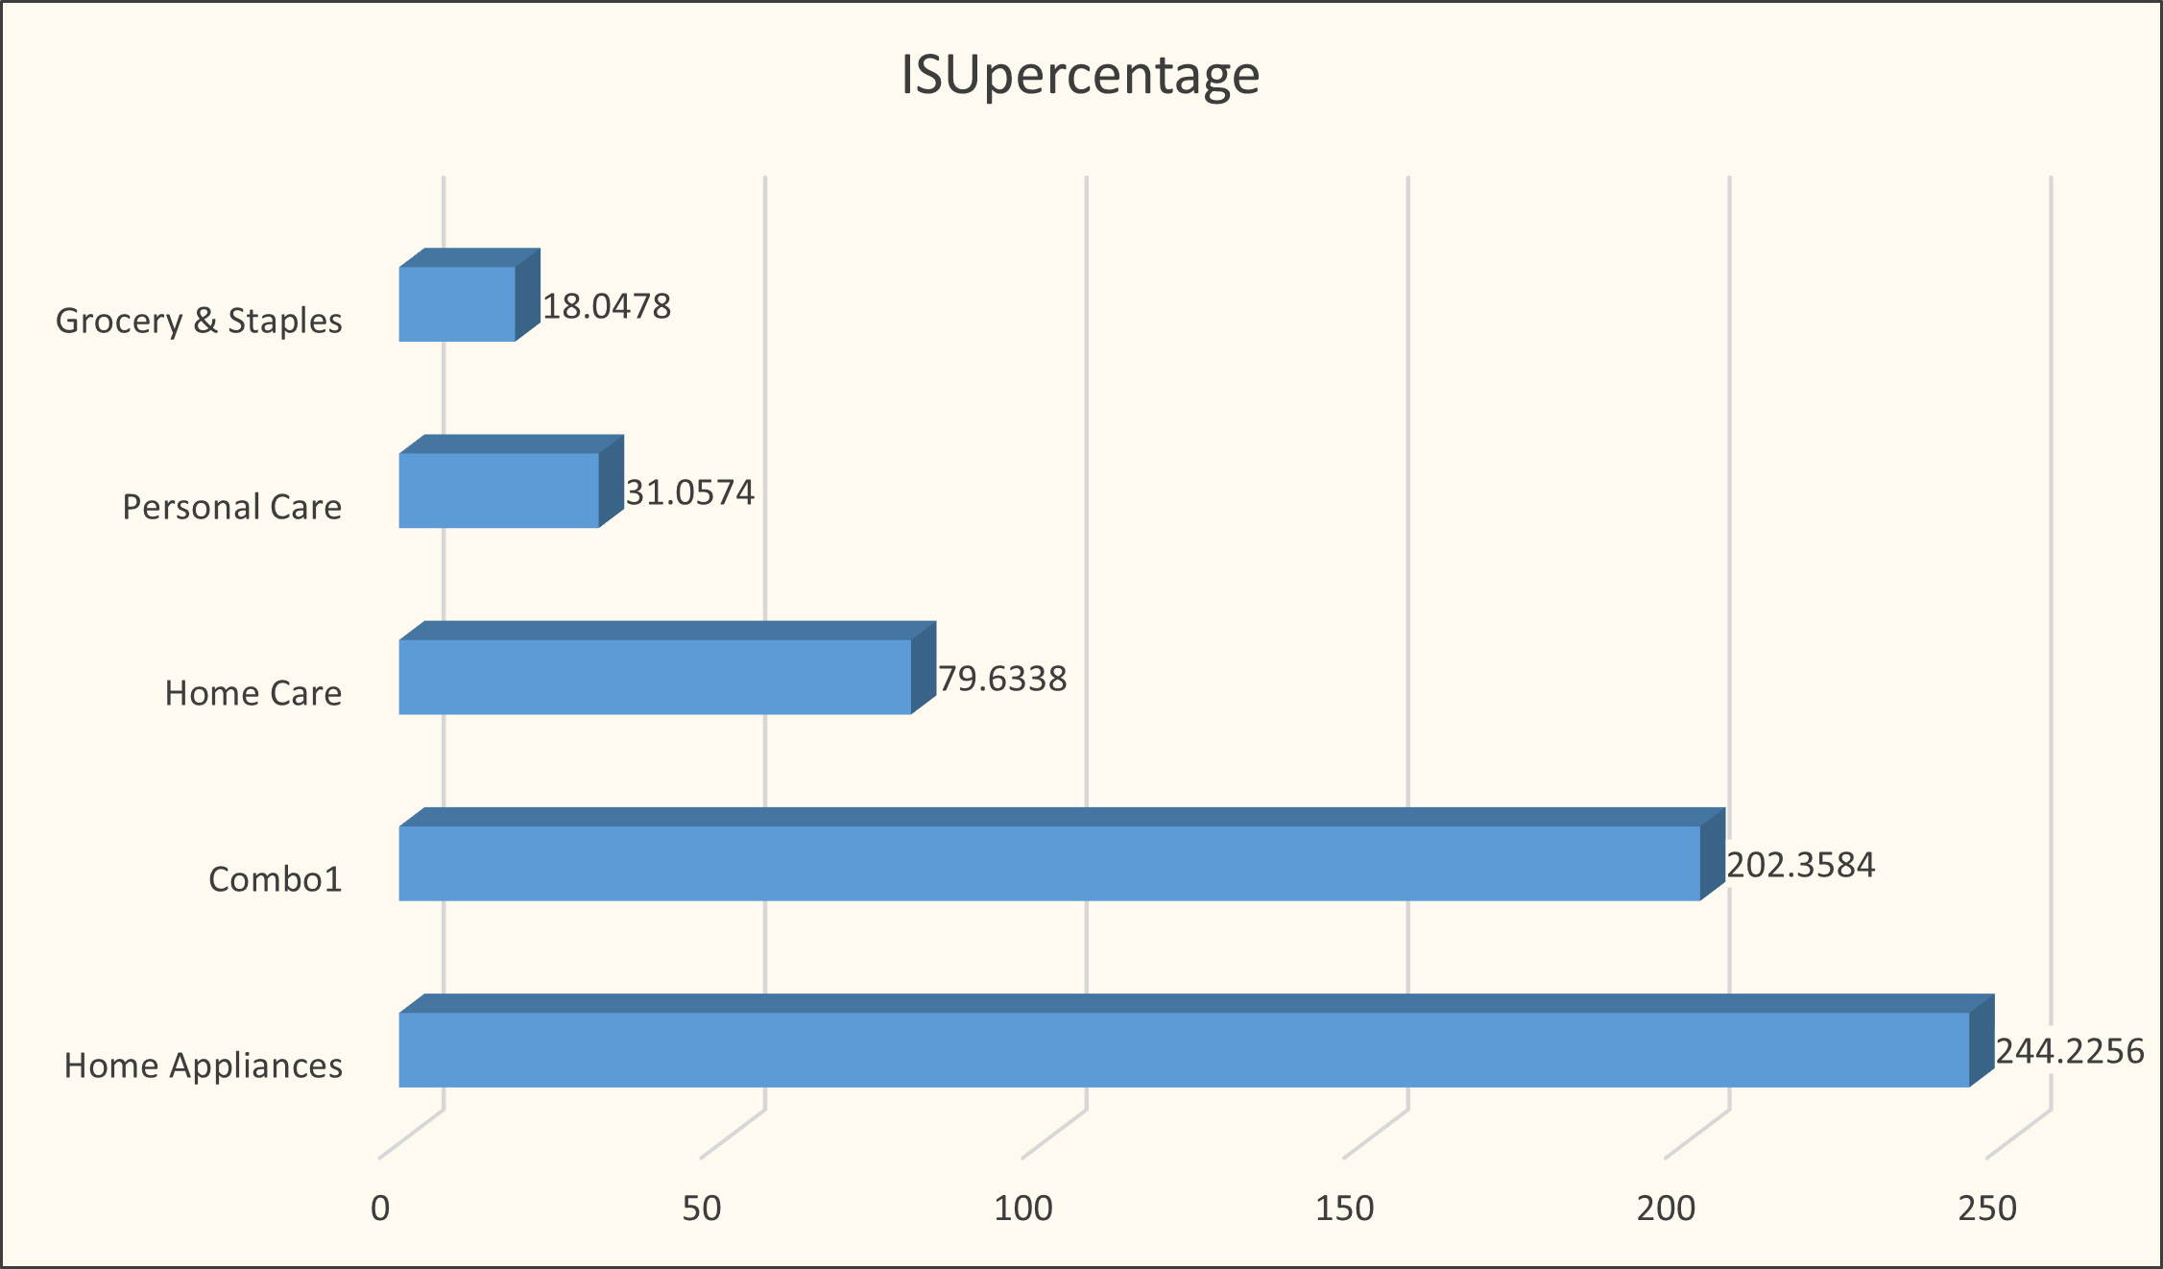
INCREMENT SOLD QUANTITY (ISU%)

Slide 17
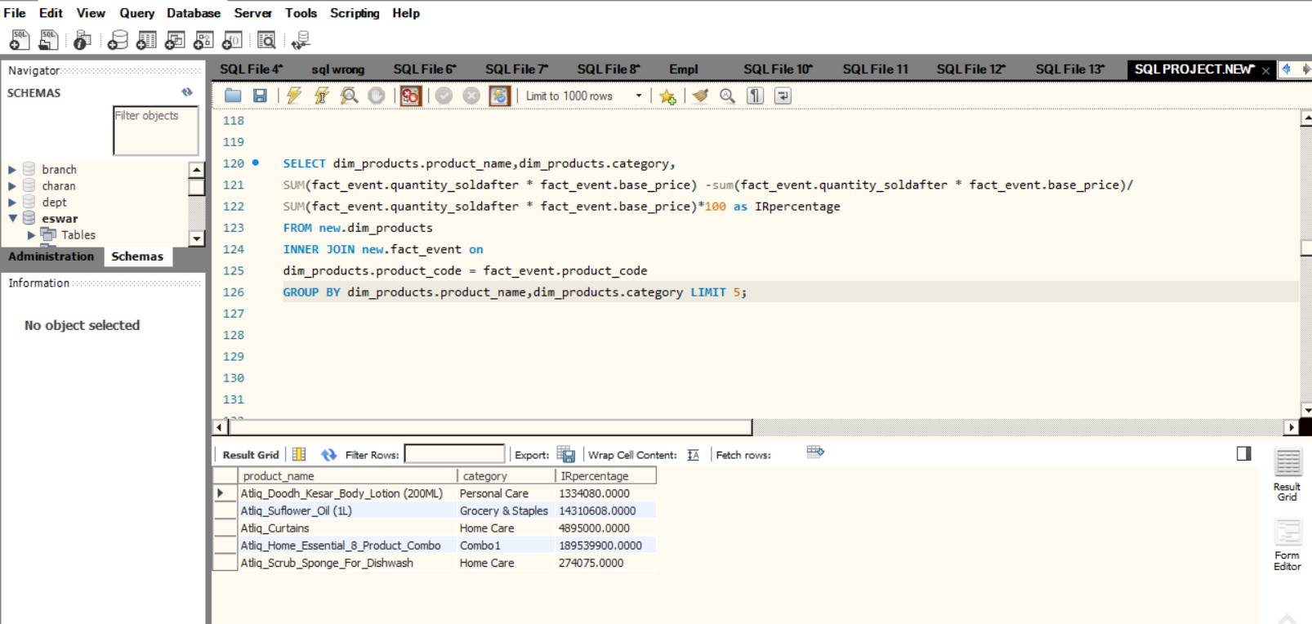
IR_PERCENTAGE (IR%)
SELECT dim_products.product_name,dim_products.category,
SUM(fact_event.quantity_soldafter * fact_event.base_price) -sum(fact_event.quantity_soldafter*fact_event.base_price)
/SUM(fact_event.quantity_soldafter * fact_event.base_price)*100 as Irpercentage
FROM new.dim_productsI
NNER JOIN new.fact_event on
dim_products.product_code = fact_event.product_code
GROUP BY dim_products.product_name,dim_products.category
LIMIT 5;

Slide 18
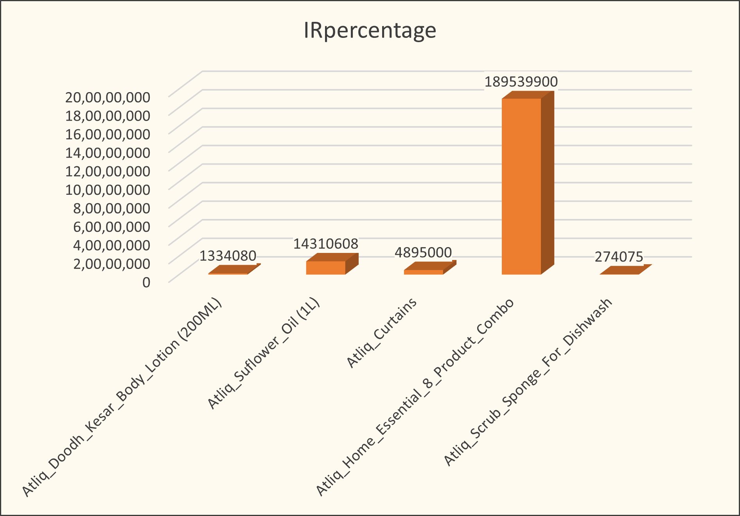
IR_PERCENTAGE (IR%)

Slide 19
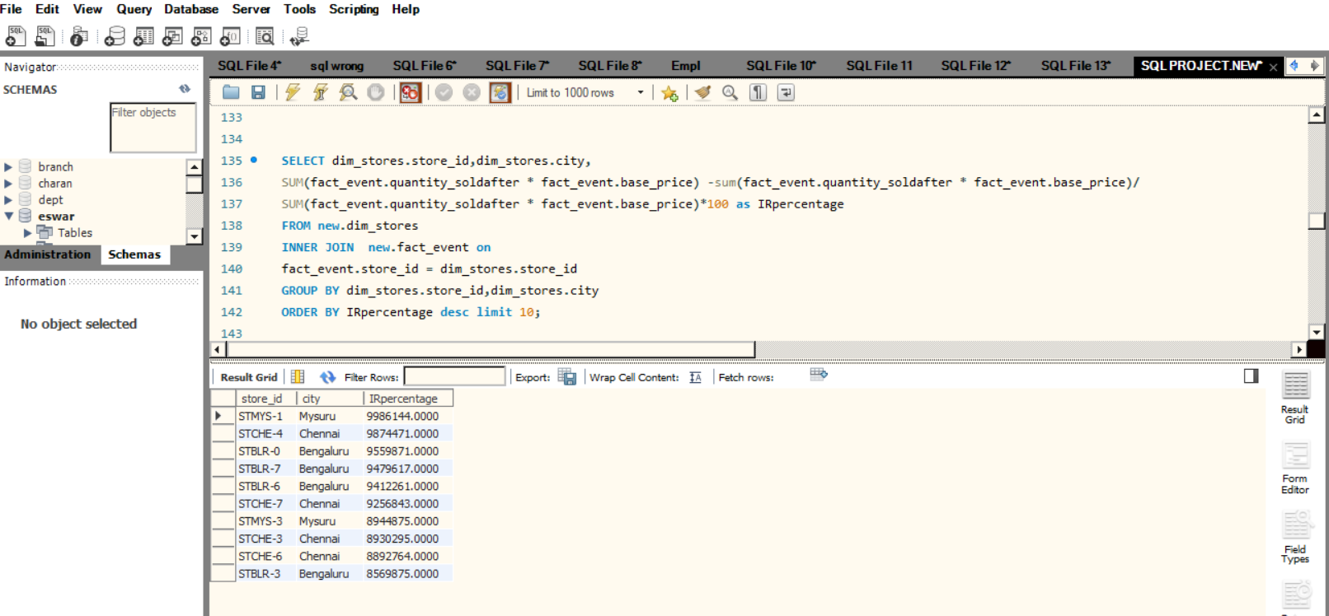
IR% BY STORES
SELECT dim_stores.store_id,dim_stores.city,SUM(fact_event.quantity_soldafter * fact_event.base_price) –
sum(fact_event.quantity_soldafter * fact_event.base_price)
/SUM(fact_event.quantity_soldafter * fact_event.base_price)*100 as Irpercentage
FROM new.dim_stores
INNER JOIN new.fact_event on
fact_event.store_id = dim_stores.store_id
GROUP BY dim_stores.store_id,dim_stores.city
ORDER BY IRpercentage desc limit 10;

Slide 20
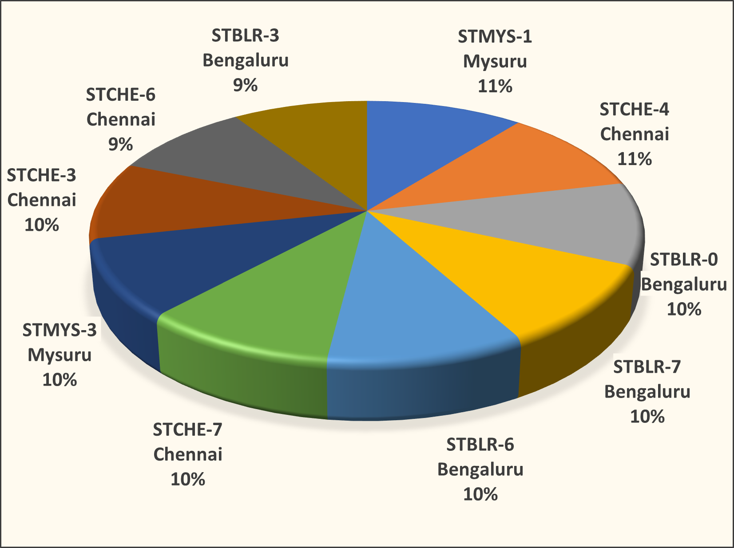
IR% BY STORES

Slide 21
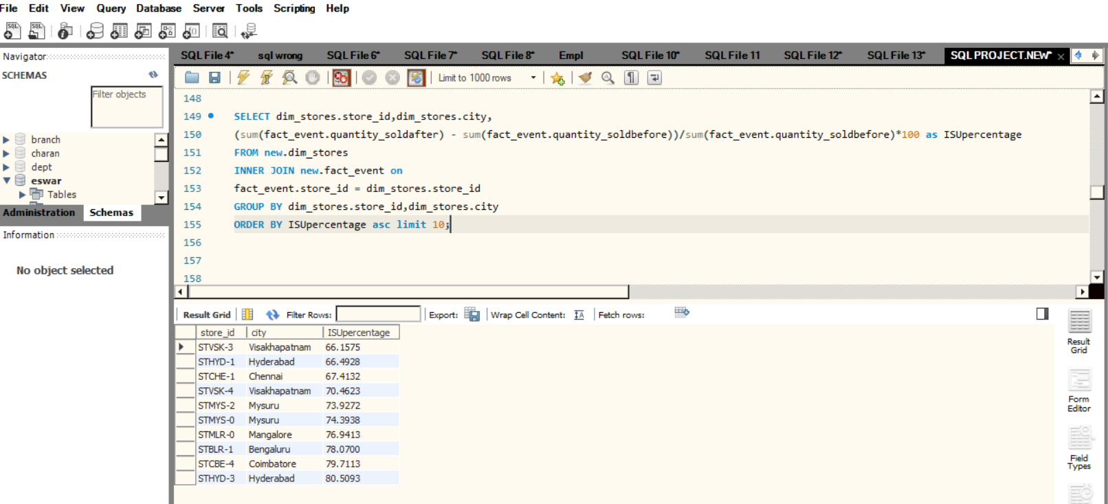
ISU% BY STORES
SELECT dim_stores.store_id,dim_stores.city,(sum(fact_event.quantity_soldafter) –
sum(fact_event.quantity_soldbefore))
/sum(fact_event.quantity_soldbefore)*100 as ISUpercentage
FROM new.dim_stores
INNER JOIN new.fact_event onfact_event.store_id = dim_stores.store_id
GROUP BY dim_stores.store_id,dim_stores.city
ORDER BY ISUpercentage asc limit 10;

Slide 22
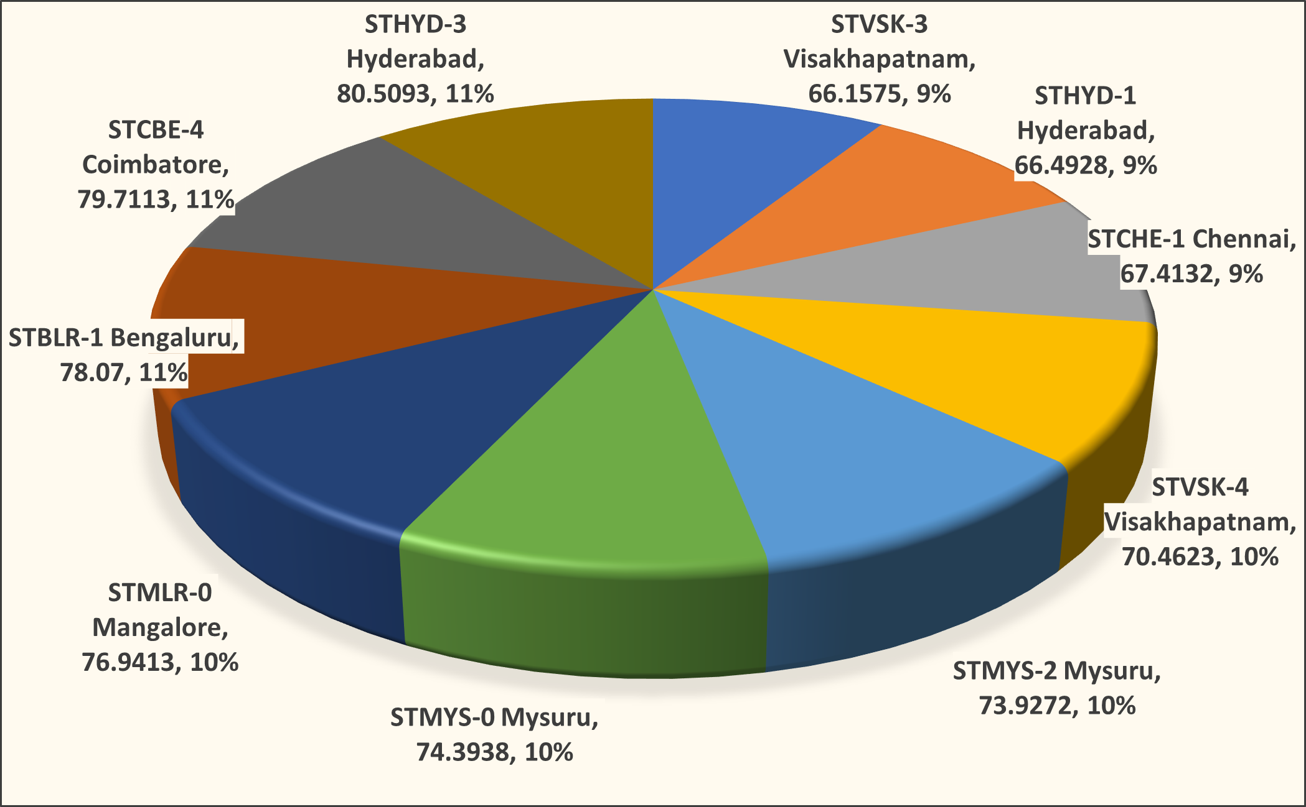
ISU% BY STORES

Slide 23
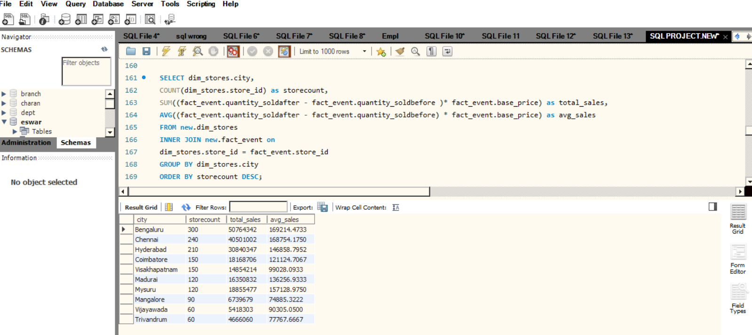
STORES VARY BY CITY
SELECT dim_stores.city,
COUNT(dim_stores.store_id) as storecount,
SUM((fact_event.quantity_soldafter - fact_event.quantity_soldbefore )* fact_event.base_price)as total_sales,
AVG((fact_event.quantity_soldafter - fact_event.quantity_soldbefore) * fact_event.base_price)as avg_sales
FROM new.dim_stores
INNER JOIN new.fact_event ondim_stores.store_id = fact_event.store_id
GROUP BY dim_stores.city
ORDER BY storecount DESC;

Slide 24
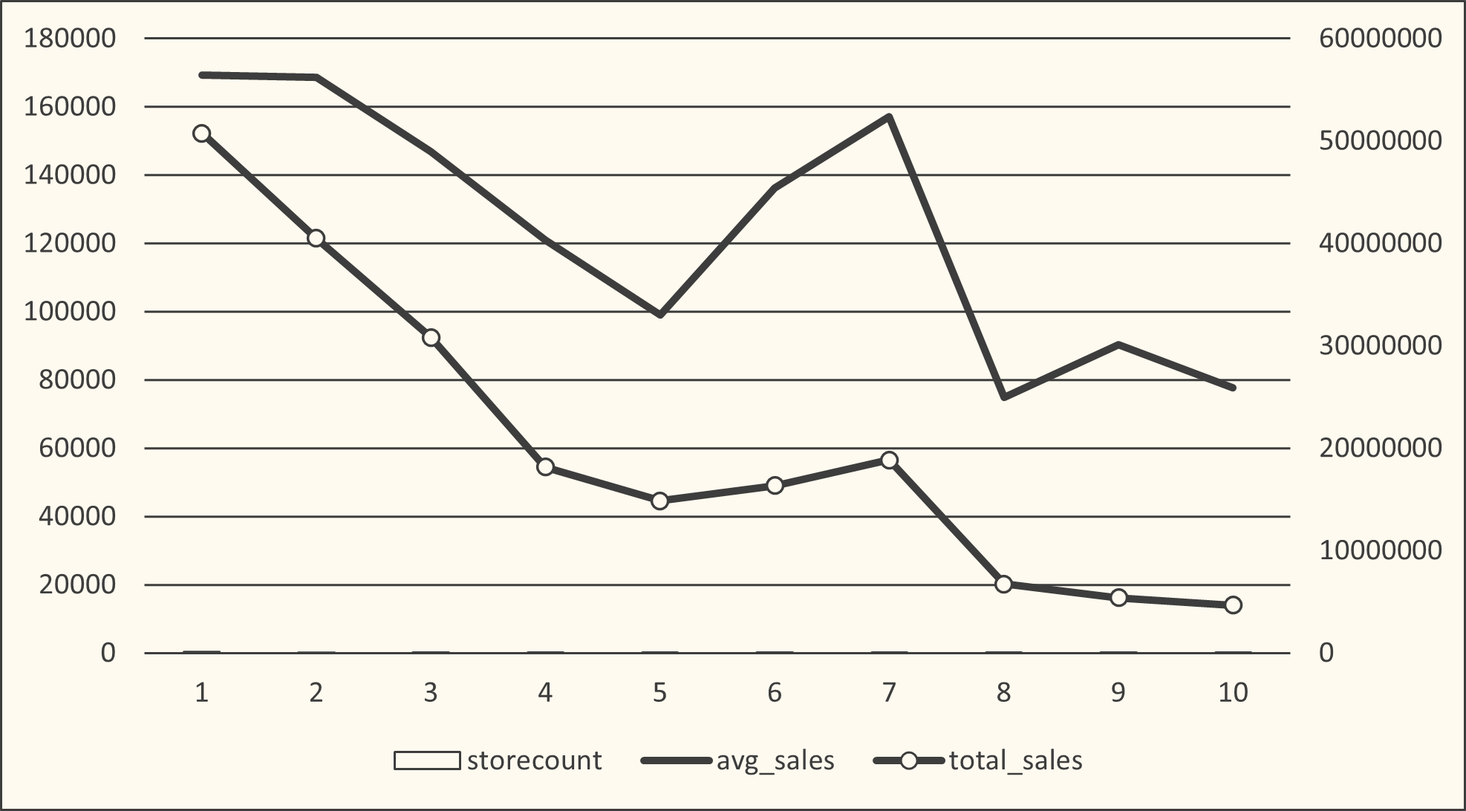
STORES VARY BY CITY
Avg_sales
Total_sales

Slide 25
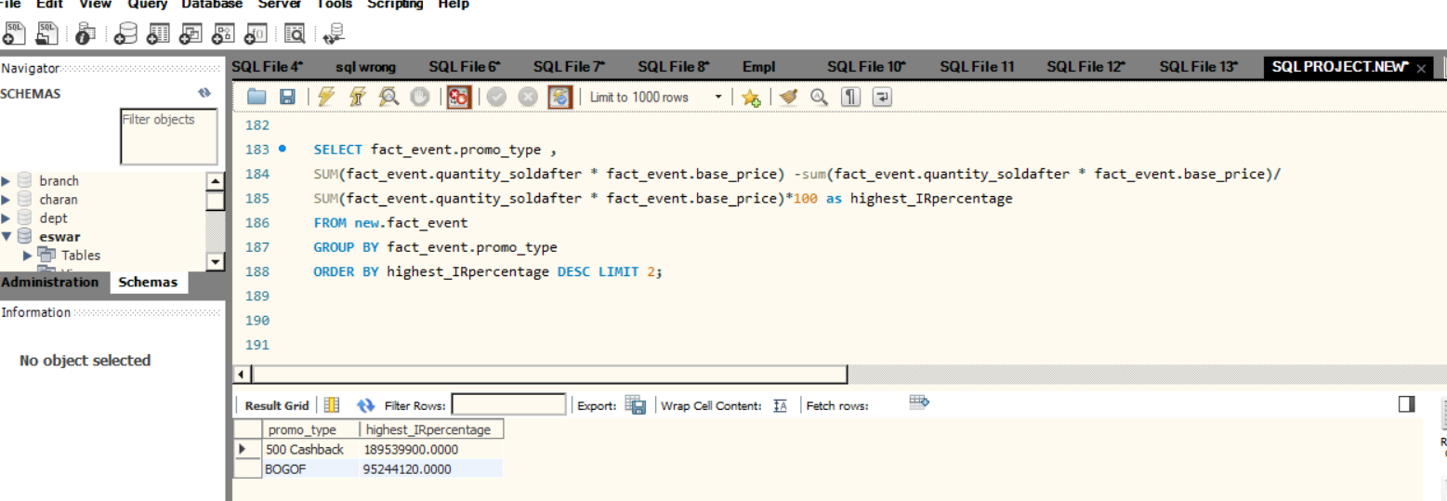
HIGHEST_INCREMENTAL_REVENUE
SELECT fact_event.promo_type,
SUM(fact_event.quantity_soldafter * fact_event.base_price) -sum(fact_event.quantity_soldafter*fact_event.base_price)
/SUM(fact_event.quantity_soldafter * fact_event.base_price)*100 as highest_IRpercentage
FROM new.fact_event
GROUP BY fact_event.promo_type
ORDER BY highest_IRpercentage DESC LIMIT 2;

Slide 26
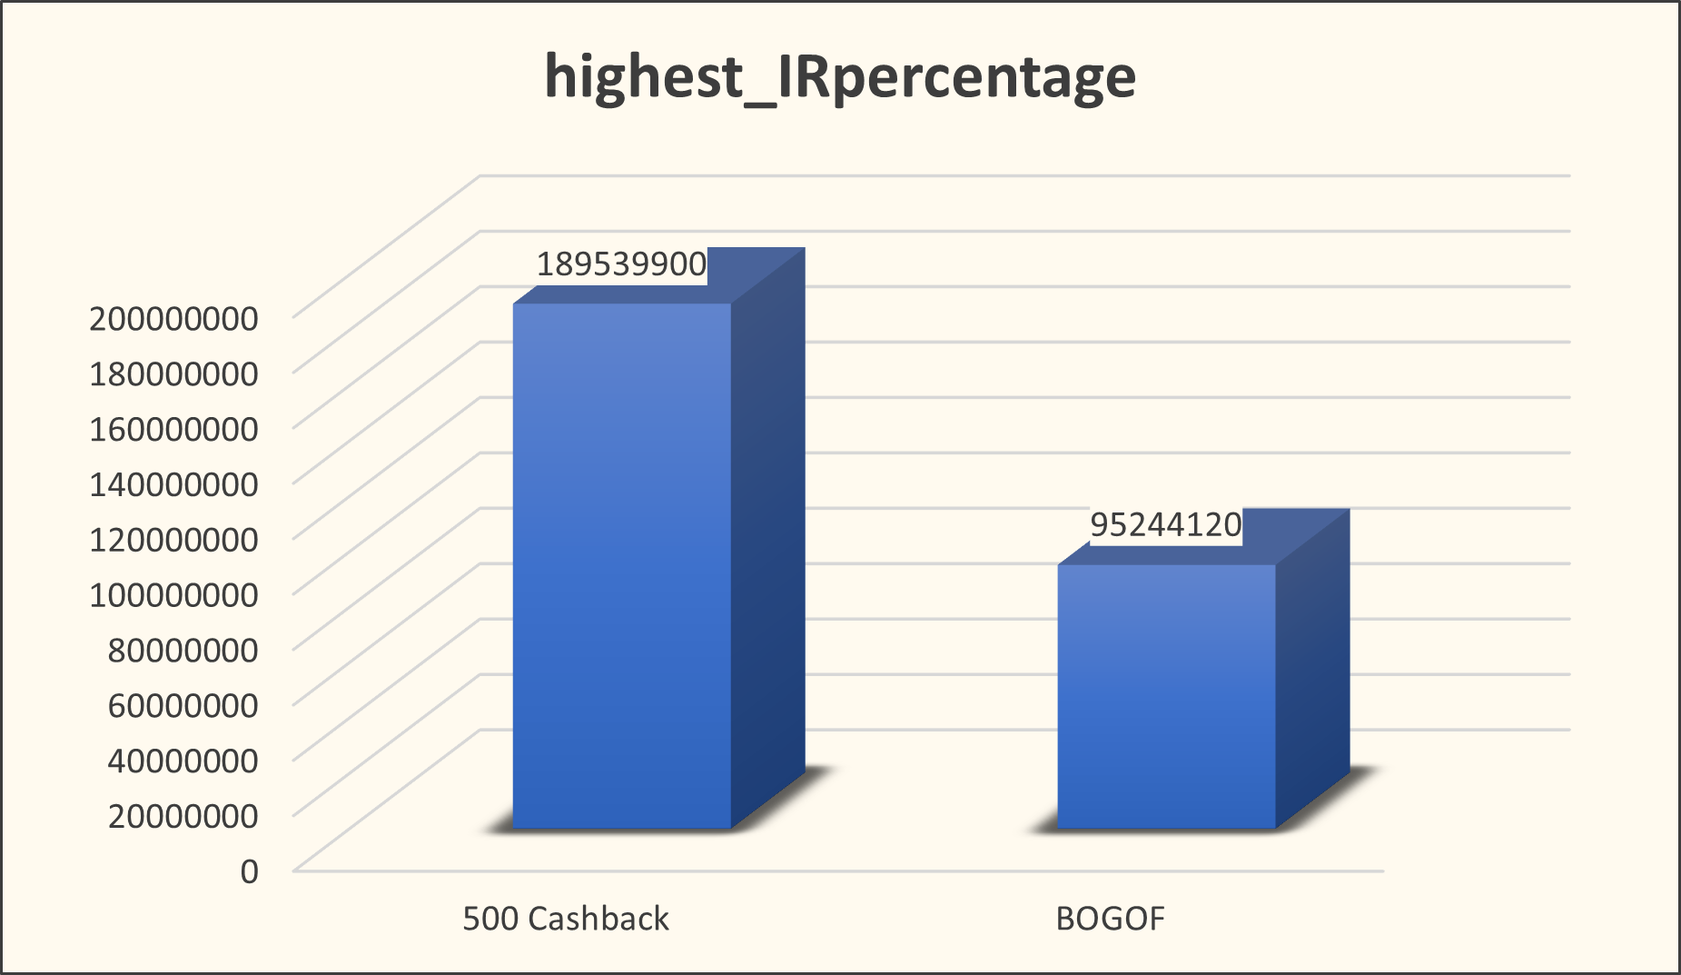
HIGHEST_INCREMENTAL_REVENUE

Slide 27
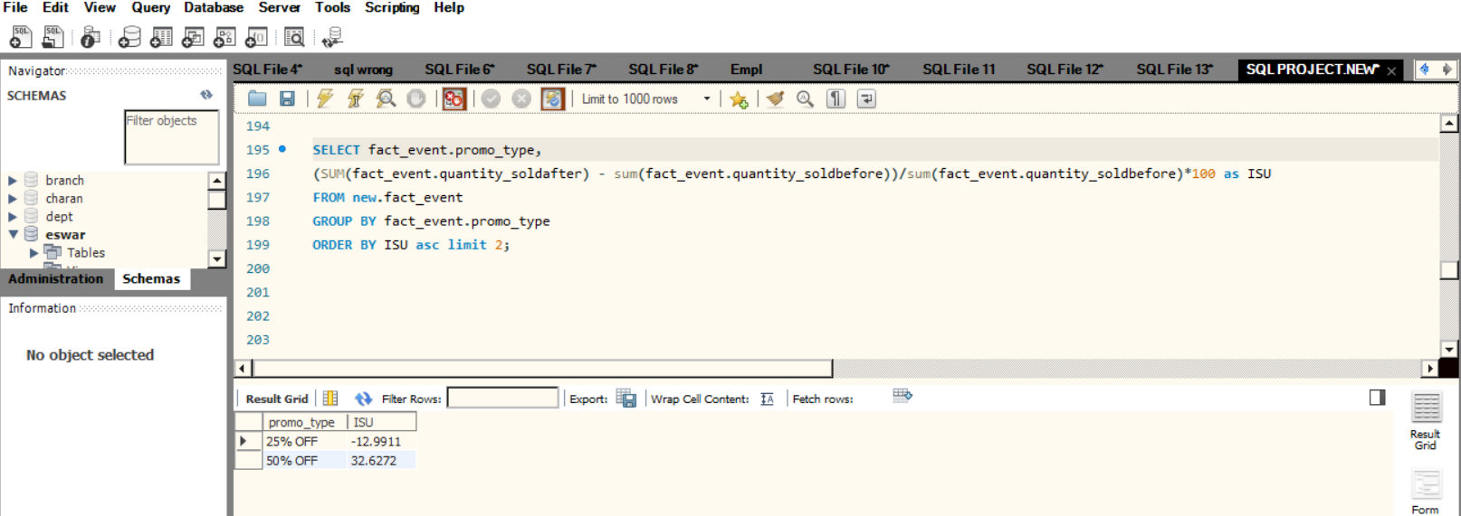
IMPACT ON INCREMENTAL_SOLD_UNIT
SELECT fact_event.promo_type,
(SUM(fact_event.quantity_soldafter) -sum(fact_event.quantity_soldbefore))/sum(fact_event.quantity_soldbefore)*100 as ISU
FROM new.fact_event
GROUP BY fact_event.promo_type
ORDER BY ISU asc limit 2;

Slide 28
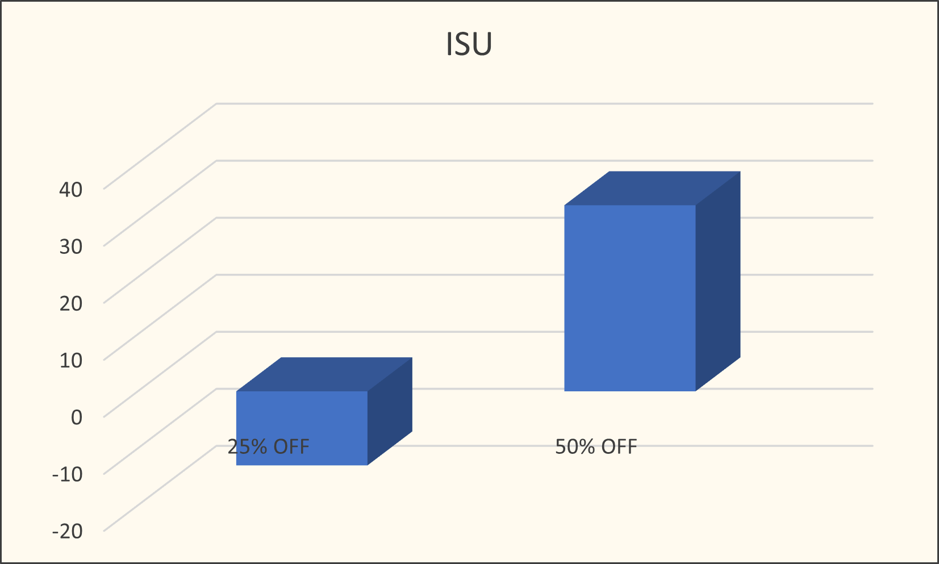
IMPACT ON INCREMENTAL_SOLD_UNIT

Slide 29
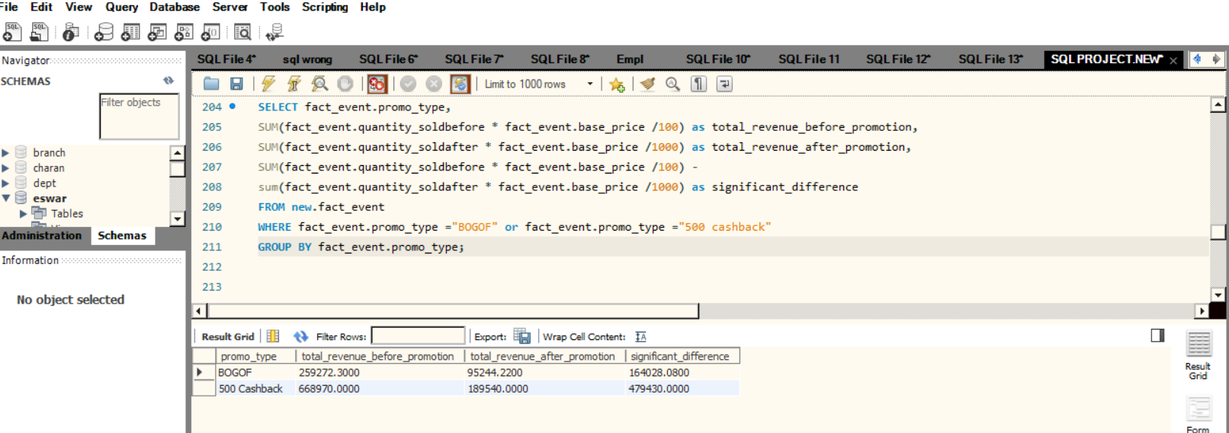
DISCOUNT BASED PROMOTIONS VERSUS BOGOF
SELECT fact_event.promo_type,
SUM(fact_event.quantity_soldbefore * fact_event.base_price /100)as total_revenue_before_promotion,
SUM(fact_event.quantity_soldafter * fact_event.base_price /1000)as total_revenue_after_promotion,
SUM(fact_event.quantity_soldbefore * fact_event.base_price /100) –
sum(fact_event.quantity_soldafter * fact_event.base_price /1000)as significant_difference
FROM new.fact_event
WHERE fact_event.promo_type ="BOGOF" or fact_event.promo_type ="500 cashback“
GROUP BY fact_event.promo_type;

Slide 30
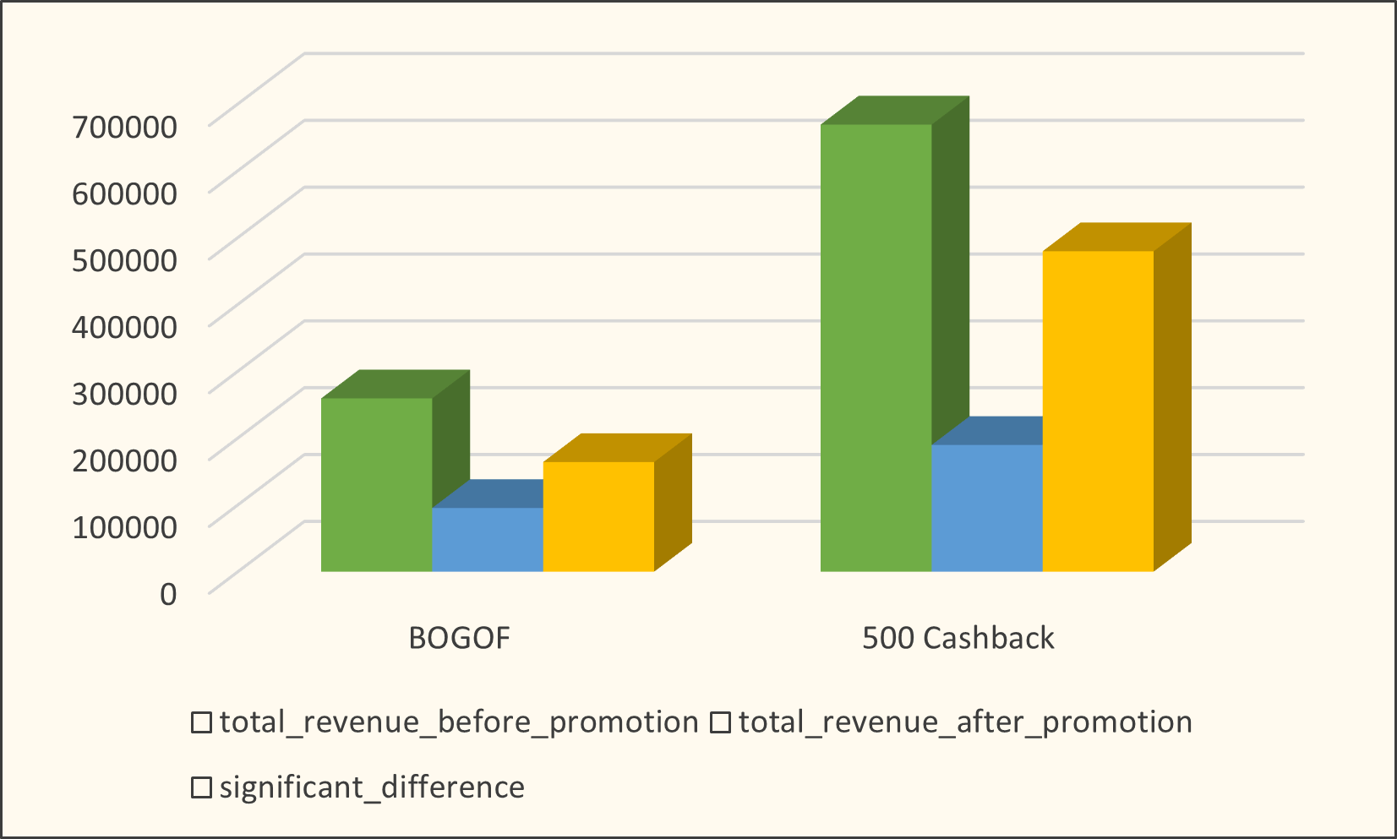
DISCOUNT BASED PROMOTIONS VERSUS BOGOF

Slide 31
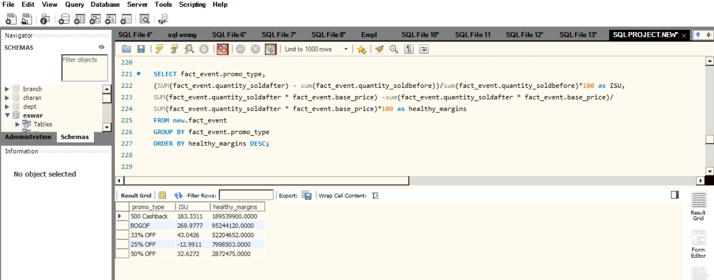
BEST_BALANCE BETWEEN ISU &HEALTHY MARGINS
SELECT fact_event.promo_type,
(SUM(fact_event.quantity_soldafter) - sum(fact_event.quantity_soldbefore))
/sum(fact_event.quantity_soldbefore)*100 as ISU,
SUM(fact_event.quantity_soldafter * fact_event.base_price) –
sum(fact_event.quantity_soldafter * fact_event.base_price)
/SUM(fact_event.quantity_soldafter * fact_event.base_price)*100 as healthy_margins
FROM new.fact_event
GROUP BY fact_event.promo_type
ORDER BY healthy_margins DESC;

Slide 32
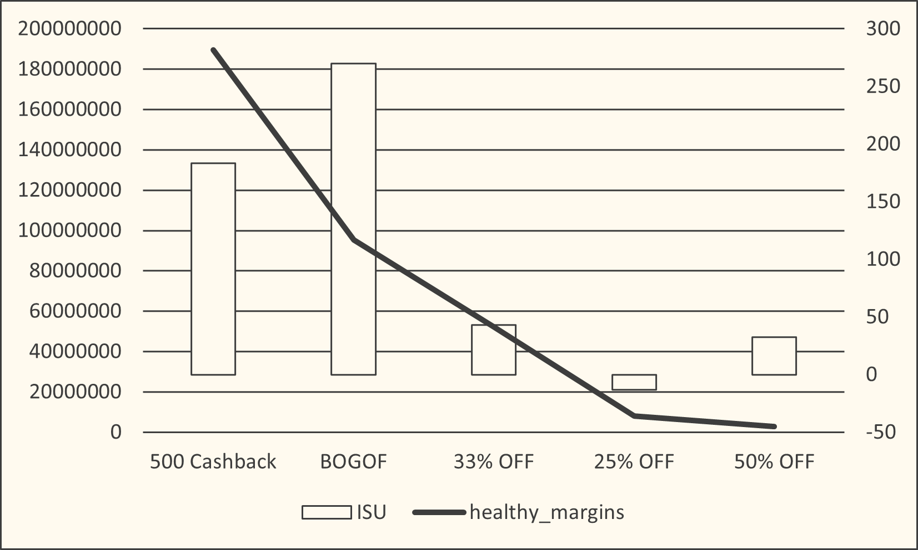
BEST_BALANCE BETWEEN ISU &HEALTHY MARGINS

Slide 33
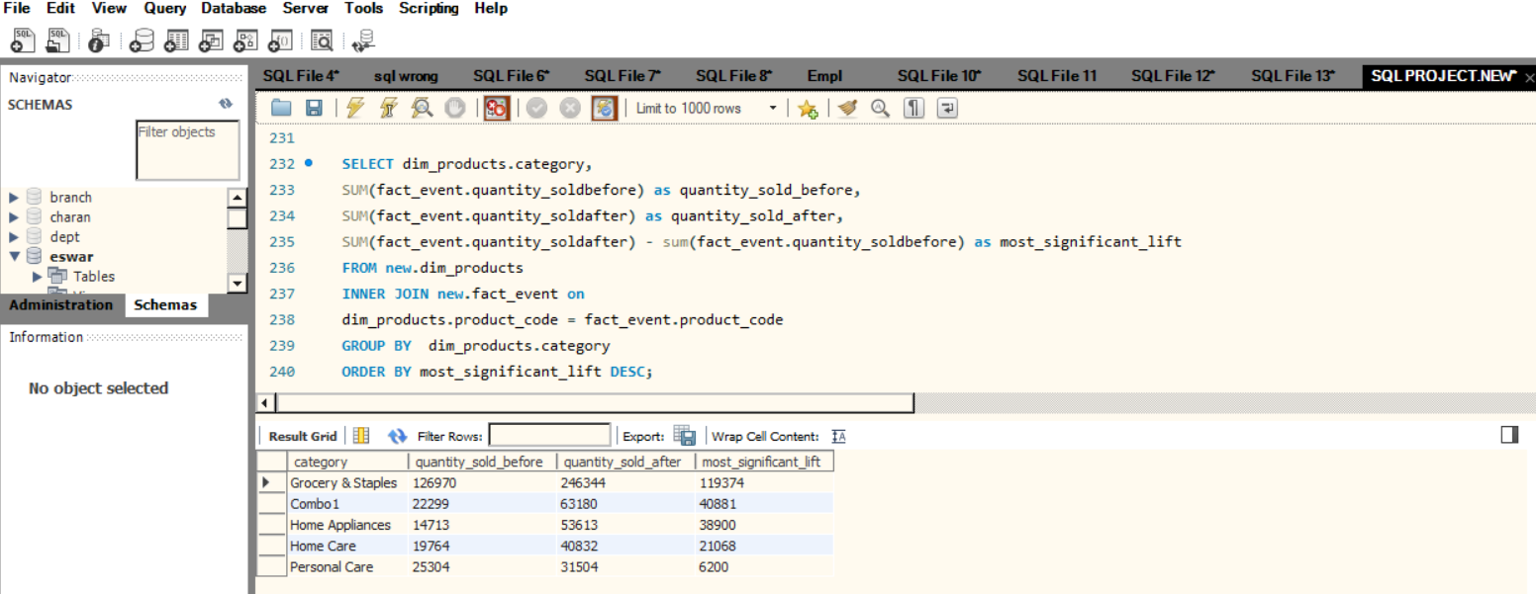
SIGNIFICANT_LIFT_IN_SALES FROM PROMOTIONS
SELECT dim_products.category,
SUM(fact_event.quantity_soldbefore)as quantity_sold_before,
SUM(fact_event.quantity_soldafter)as quantity_sold_after,
SUM(fact_event.quantity_soldafter) - sum(fact_event.quantity_soldbefore)as most_significant_lift
FROM new.dim_products
INNER JOIN new.fact_event on
dim_products.product_code = fact_event.product_code
GROUP BY dim_products.category
ORDER BY most_significant_lift DESC;

Slide 34
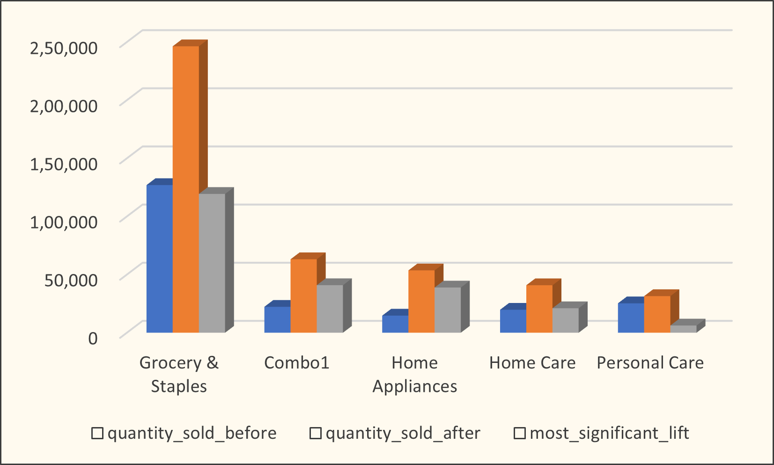
SIGNIFICANT_LIFT_IN_SALES FROM PROMOTIONS

Slide 35
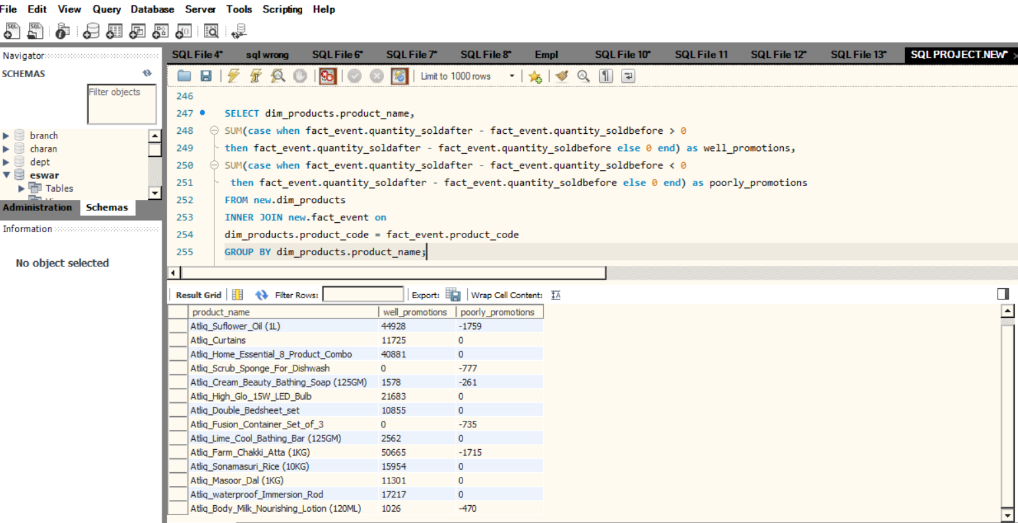
PRODUCTS WITH PROMOTIONS
SELECT dim_products.product_name,
SUM(case when fact_event.quantity_soldafter - fact_event.quantity_soldbefore > 0
then fact_event.quantity_soldafter - fact_event.quantity_soldbefore else 0 end)as well_promotions,
SUM(case when fact_event.quantity_soldafter - fact_event.quantity_soldbefore < 0
then fact_event.quantity_soldafter - fact_event.quantity_soldbefore else 0 end)as poorly_promotions
FROM new.dim_products
INNER JOIN new.fact_event on
dim_products.product_code = fact_event.product_code
GROUP BY dim_products.product_name;

Slide 36
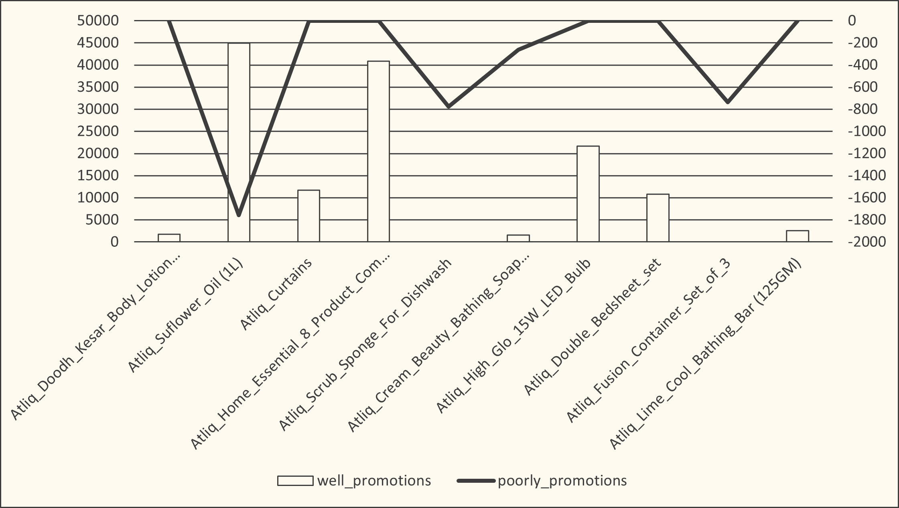
PRODUCTS WITH PROMOTIONS

Slide 37
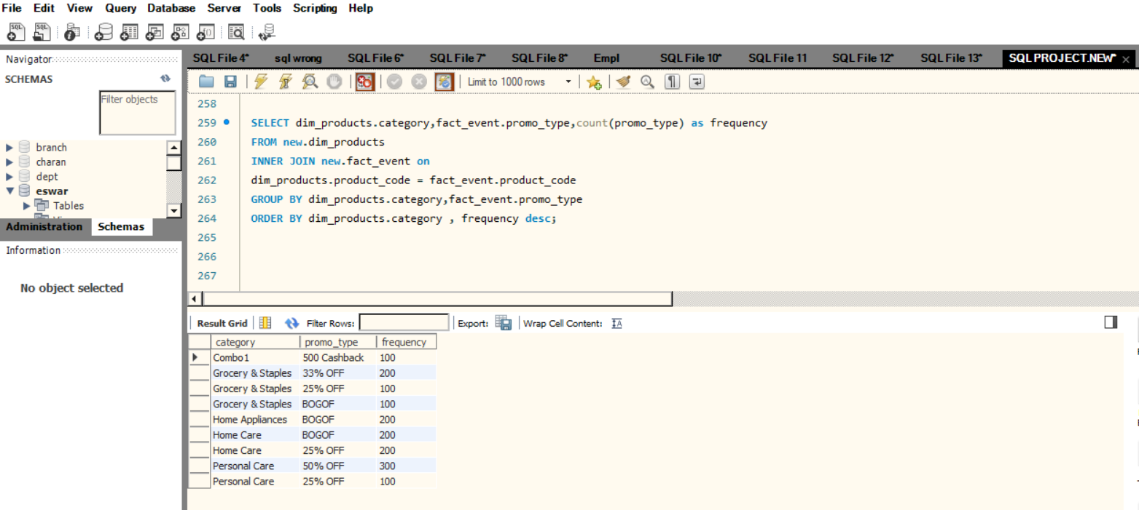
CATEGORY & PROMOTION_TYPE EFFECTIVENESS
SELECT dim_products.category,fact_event.promo_type,
count(promo_type) as frequency
FROM new.dim_products
INNER JOIN new.fact_event on
dim_products.product_code = fact_event.product_code
GROUP BY dim_products.category,fact_event.promo_type
ORDER BY dim_products.category , frequency desc;

Slide 38
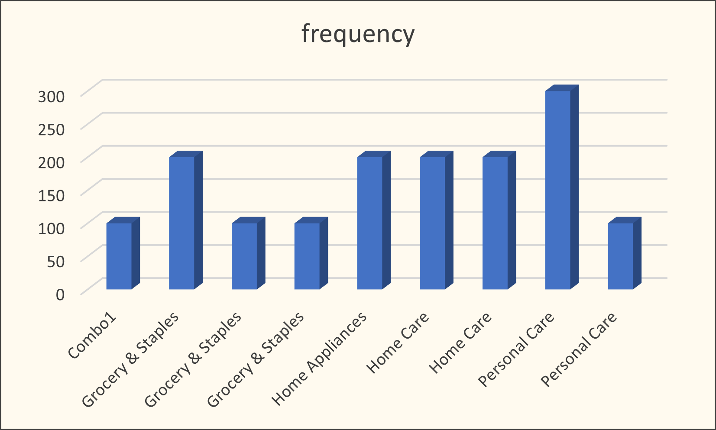
CATEGORY & PROMOTION_TYPE EFFECTIVENESS

Slide 39
CONCLUSION
This retail events analysis categorizing promotions and analyzing their performance, we identified which types of promotions generate the incremental revenue. This understanding allows us to allocate resources more effectively and optimize promotional strategies.

